Slide 1

Chapter 2
Demand and Supply Analysis

Slide 2

Chapter Two Overview
Motivation – U.S. corn markets
Competitive Markets Defined
The Market Demand Curve
The Market Supply Curve
Equilibrium
6. Characterizing Demand and Supply – Elasticity
7. Back of the Envelope Techniques
Chapter Two

Slide 3
Motivations
Example: U.S. Corn Market
Historical price:
$2.00 per bushel
2003-2004:
Prices rose to $3.00 per bushel
2004-2005:
Prices fell below $2.00 per bushel
2006-2008:
Prices rose above $5.00 per bushel
2008-2009:
Prices fell to $3.90 per bushel
Why do prices vary so much?
Changes in Supply and Demand conditions affects pattern of prices
Chapter Two

Slide 4
Motivations
Example: U.S. Corn Market
2002-2003
Decrease in supply due to drought in the corn-growing states
2004-2005
Unexpectedly large U.S. corn crops
2006-2008
Changes in U.S. government policy
Bubble years
Increase in production costs due to oil price increases and rains and flooding wiped out corn crop
2008-2009
Weather conditions back to normal
Economic Crisis
Chapter Two

Slide 5
Competitive Markets
Defined:
Competitive Markets are those with sellers and buyers that are small and numerous enough that they take the market price as given when they decide how much to buy and sell.
Chapter Two

Slide 6

The Market Demand Function
Defined:
The Market Demand Function tells us that the quantity of a good all consumers in the market are willing to buy is a function of various factors.
Chapter Two

Slide 7
Market Demand
Derived Demand
The part of demand for a good that is derived from the production and sale of other goods.
Direct Demand
The part of demand for a good that comes from the desire of buyers to directly consume the good itself.
Chapter Two

Slide 8

The Market Demand Curve
Defined:
The Market Demand Curve plots the aggregate quantity of a good that consumers are willing to buy at different prices, holding constant other demand drivers such as prices of other goods, consumer income, quality.
Chapter Two

Slide 9
The Law of Demand
Defined:
The Law of Demand states that the quantity of a good demanded decreases when the price of this good increases.
Chapter Two

Slide 10
Demand Curve Rule
Defined:
A move along the demand curve for a good can only be triggered by a change in the price of that good. Any change in another factor that affects the consumers’ willingness to pay for the good results in a shift in the demand curve for the good.
Chapter Two

Slide 11
Shifts of the Demand Curve
The Demand Curve shifts when factors other than own
price change
If the change increases the willingness of consumers to acquire the good, the demand curve shifts right
If the change decreases the willingness of consumers to acquire the good, the demand curve shifts left
Chapter Two

Slide 12
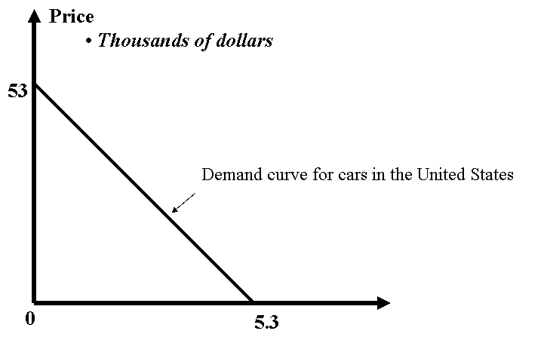
The Demand for Cars
Chapter Two

Slide 13

The Demand for Cars
Note:
We always graph P on vertical axis and Q on horizontal axis, but we write demand as Q as a function of P… If P is written as function of Q, it is called the inverse demand.
Markets defined by commodity, geography, time.
Chapter Two

Slide 14


Market Supply
The Market Supply Function:
Tells us that the quantity of a good supplied by all producers in the market depends on various factors
The Market Supply Curve:
Plots the aggregate quantity of a good that producers are willing to sell at different prices.
Chapter Two

Slide 15
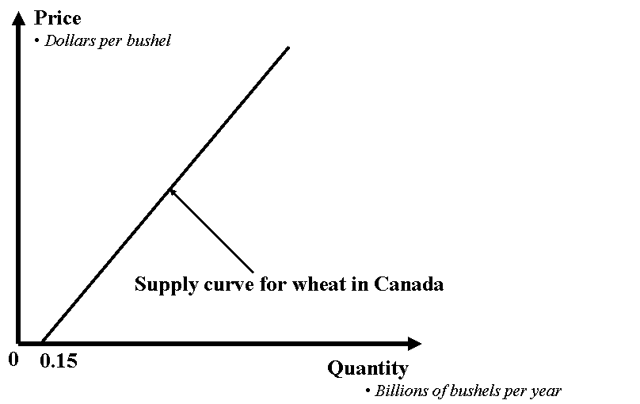
Supply Curve for Wheat
Chapter Two

Slide 16
The Law of Supply
Defined:
The Law of Supply states that the quantity of a good offered increases when the price of this good increases.
Chapter Two

Slide 17
Supply Curve Rule
Defined:
A move along the supply curve for a good can only be triggered by a change in the price of that good. Any change in another factor that affects the producers’ willingness to offer for the good results in a shift in the supply curve for the good.
Chapter Two

Slide 18
The Law of Supply
The Supply Curve shifts when factors other than own price change
If the change increases the willingness of producers to offer the good at the same price, the supply curve shifts right
If the change decreases the willingness of producers to offer the good at the same price, the supply curve shifts left
Chapter Two

Slide 19

Market Equilibrium
Market Equilibrium
is a price such that, at this price, the quantities demanded and supplied are the same.
is a point at which there is no tendency for the market price to change as long as exogenous variables remain unchanged.
Demand and supply curves intersect at equilibrium
Supply
Demand
Chapter Two

Slide 20
Example: Market Equilibrium for Cranberries
Q_{d} = 500 – 4p
Q_{s} = -100 + 2p
p = price of cranberries (dollars per barrel)
Q = demand or supply in millions of barrels per year
The equilibrium price of cranberries is calculated by equating demand to supply:
Q_{d} = Q_{s} … or…
500 – 4p = -100 + 2p …solving
p* = $100
Plug equilibrium price into either demand or supply to get equilibrium quantity:
Q* = 500 – 4(100) = 100 units
Chapter Two

Slide 21
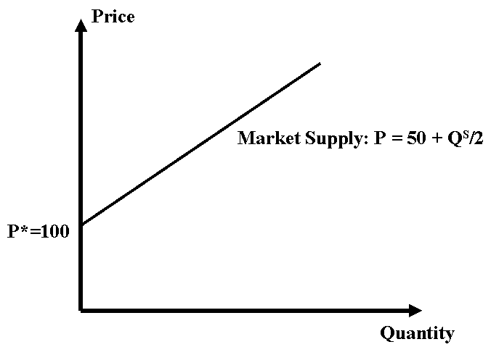
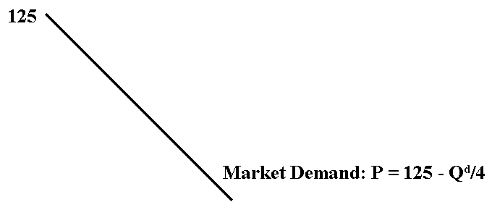
Market Equilibrium for Cranberries
Q* = 100
Chapter Two

Slide 22
Excess Demand/Supply
Excess Demand: A situation in which the quantity demanded at a given price exceeds the quantity supplied.
Excess Supply: A situation in which the quantity supplied at a given price exceeds the quantity demanded.
If there is no excess supply or excess demand, there is no pressure for prices to change and thus there is equilibrium.
When a change in an exogenous variable causes the demand curve or the supply curve to shift, the equilibrium shifts as well.
Chapter Two

Slide 23
Excess Demand/Supply
Excess supply when price is $5
Price (dollars per bushel)
S
5.00
E
4.00
3.00
Excess demand when price is $3
D
8
9
11
13
14
Quantity (billions of bushels per year)
Chapter Two

Slide 24
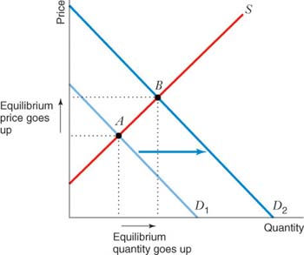
Shifts in Demand, Supply Unchanged
Demand Increases:
P↑ Q↑
Demand Decreases:
P↓ Q ↓

Slide 25
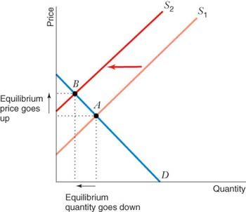
Shifts in Supply, Demand Unchanged
Supply Increases:
P ↓ Q↑
Supply Decreases:
P ↑ Q ↓

Slide 26
Shifts in Demand and Supply

Slide 27
Price Elasticity
Defined:
The Price Elasticity of Demand is the percentage change in quantity demanded brought about by a one-percent change in the price of the good.
ε_{Q,P}= (ΔQ/Q) = (ΔQ/Δp)(p/Q)
(Δp/p)
Chapter Two

Slide 28
Price Elasticity
Elasticity is not slope
Slope is the ratio of absolute changes in quantity and price. (= ΔQ/ΔP).
Elasticity is the ratio of relative (or percentage) changes in quantity and price.
Chapter Two

Slide 29
Price Elasticity
Key Characteristics:
When a one percent change in price leads to a greater than one-percent change in quantity demanded, the demand curve is elastic. (εQ,P < -1)
When a one-percent change in price leads to a less than one-percent change in quantity demanded, the demand curve is inelastic. (0 > εQ,P > -1)
When a one-percent change in price leads to an exactly one-percent change in quantity demanded, the demand curve is unit elastic. (εQ,P = -1)
Chapter Two

Slide 30
Elasticity – Linear Demand Curve
Q_{d} = a – bP
Re-writing, we have:
P = a/b – (1/b)Q
Where:
a and b are positive constants
p is price
b is the slope
a/b is the choke price
Elasticity is:
ε_{Q,P} = (ΔQ/ ΔP)(P/Q) = -b(P/Q)
Elasticity falls from 0 to -∞ along the linear demand curve, but slope is constant.
Example: Calculate elasticity when P = 30 and Q_{d} = 400 – 10P
Answer: ε_{Q,P} = -3 “elastic”
Chapter Two

Slide 31
Elasticity – Linear Demand Curve
P
ε_{Q,P} = -∞
a/b
Elastic region
•
ε_{Q,P} = -1
a/2b
Inelastic region
ε_{Q,P} = 0
a
Q
0
a/2
Chapter Two

Slide 32
Constant Elasticity vs. Linear Demand Curve
Linear Demand Curve:
Q_{d} = a -bP
ε_{Q,P} = (ΔQ/ ΔP)(P/Q) = -b(P/Q)
Price
Constant Elasticity Demand Curve:
Q_{d} = aP^{-b}
ε_{Q,P} = -b
•
Observed price and quantity
P
Constant elasticity demand curve
Linear demand curve
0
Q
Quantity
Chapter Two

Slide 33
Price Elasticity and Total Revenue
Total Revenue (TR) = P*Q
When P↑ Q↓ and when P↓ Q↑
Demand is elastic
Fall in Q > Rise in P TR falls
Demand is inelastic
Fall in Q < Rise in P TR falls
Chapter Two

Slide 34
Determinants of Price Elasticity of Demand
Availability of Substitutes
More substitutes → more price elastic
Goods which have price inelastic at the market level, like cigarettes, can be highly price elastic at the brand level
Necessities versus Luxuries
Necessities → less price elastic
Importance in Buyer’s Budget
More important → more price elastic
Time Horizon
Long-run → more price elastic
Chapter Two

Slide 35
Elasticity in the Long-run versus the Short-run
Long-run demand curve – demand curve when consumers can fully adjust their purchase decisions to changes in price
Short-run demand curve – demand curve when consumers can fully adjust their purchase decisions to changes in price
Long-run supply curve – supply curve when sellers can fully adjust their supply decisions to changes in price
Short-run supply curve – supply curve when sellers can fully adjust their supply decisions to changes in price
Chapter Two

Slide 36
Durable Goods
Defined:
The Durable Good is a good that provides valuable services over a long time (usually many years).
Demand for non-durables is less elastic in the short run when consumers can only partially adapt their behavior. Demand for durables is more elastic in the short run because consumers can delay purchase.
Chapter Two

Slide 37
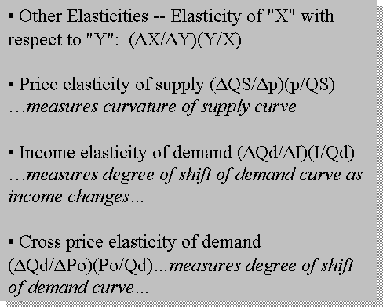
Other Elasticities
Chapter Two

Slide 38
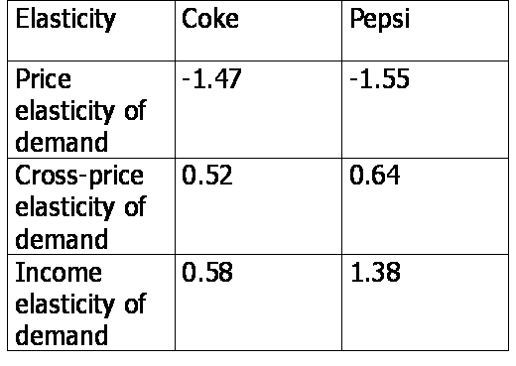
Elasticities & the Cola Wars
Source: Gasmi, Laffont and Vuong, "Econometric Analysis of Collusive Behavior in a Soft Drink Market," Journal of Economics and Management Strategy 1 (Summer, 1992) 278-311.
Chapter Two

Slide 39
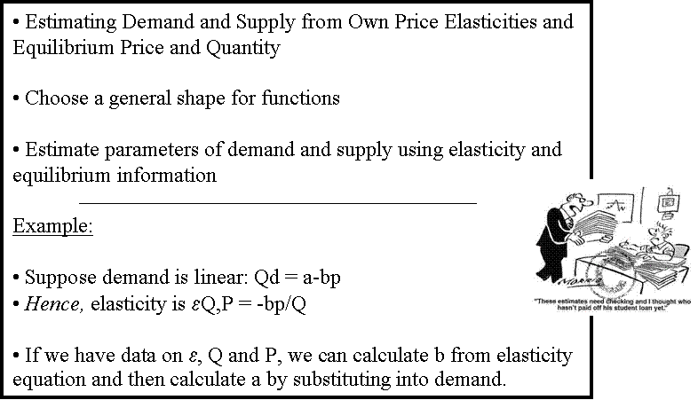
Estimating Demand & Supply
Estimating
Elasticity
Chapter Two

Slide 40
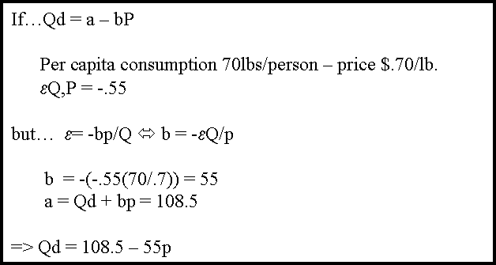
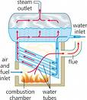
Estimating Demand & Supply
Example:
U.S. Broilers
1990
Chapter Two

Slide 41
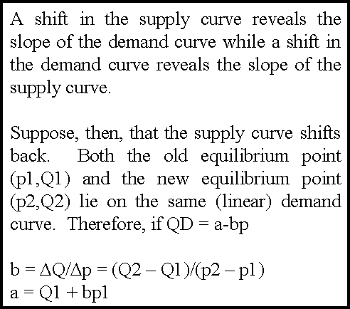
Estimating Demand & Supply
From Past Shifts
We can “identify” the slope of supply by a shift in demand
We can “identify” the slope of demand by a shift in supply
This technique only works if one or the other of the curves stays constant
Chapter Two

Slide 42
Chapter Two Main Points
Market Demand Function and Curve
Market Supply Function and Curve
Equilibrium
Measures of Elasticity
Back-of-the-Envelope Calculations
Chapter Two

